Slide 1


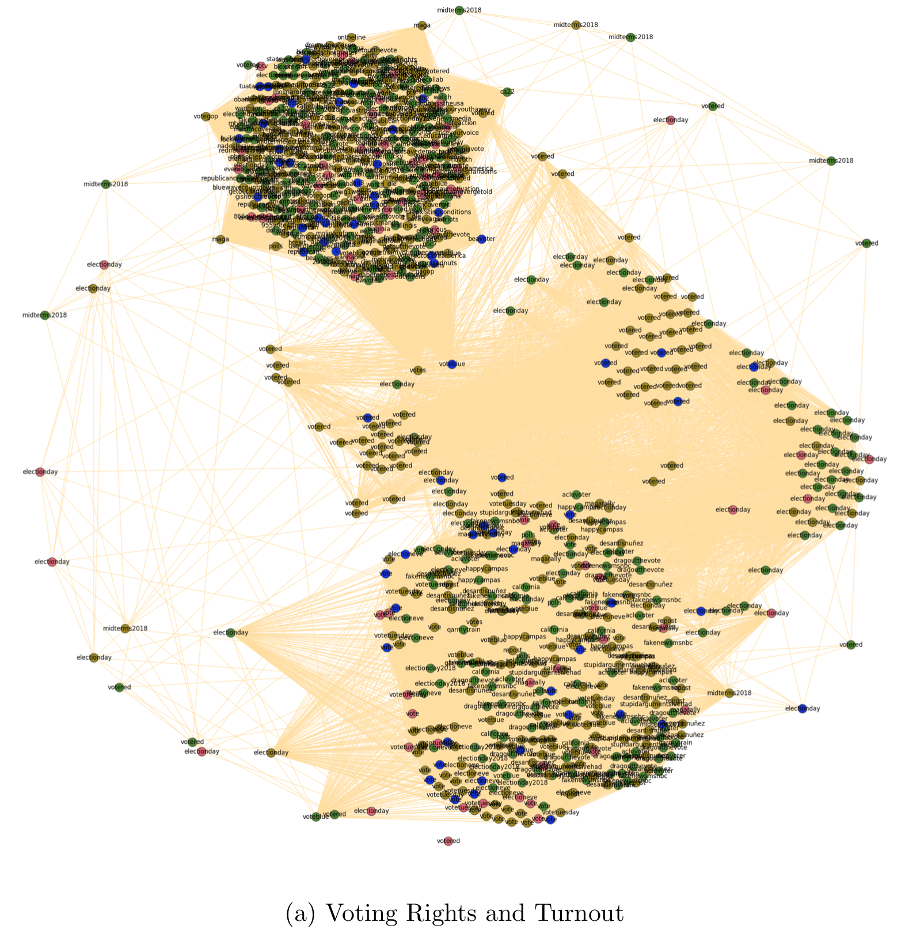
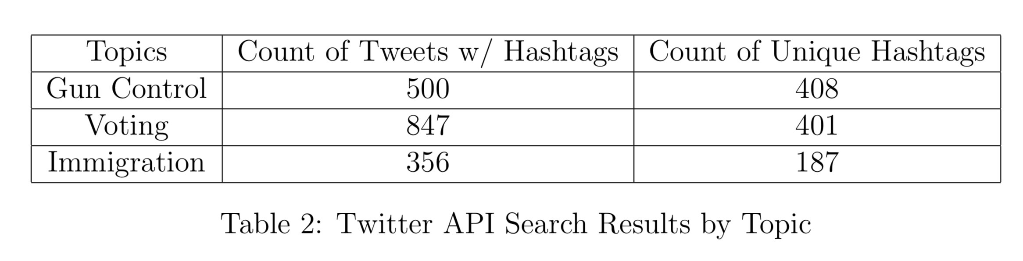
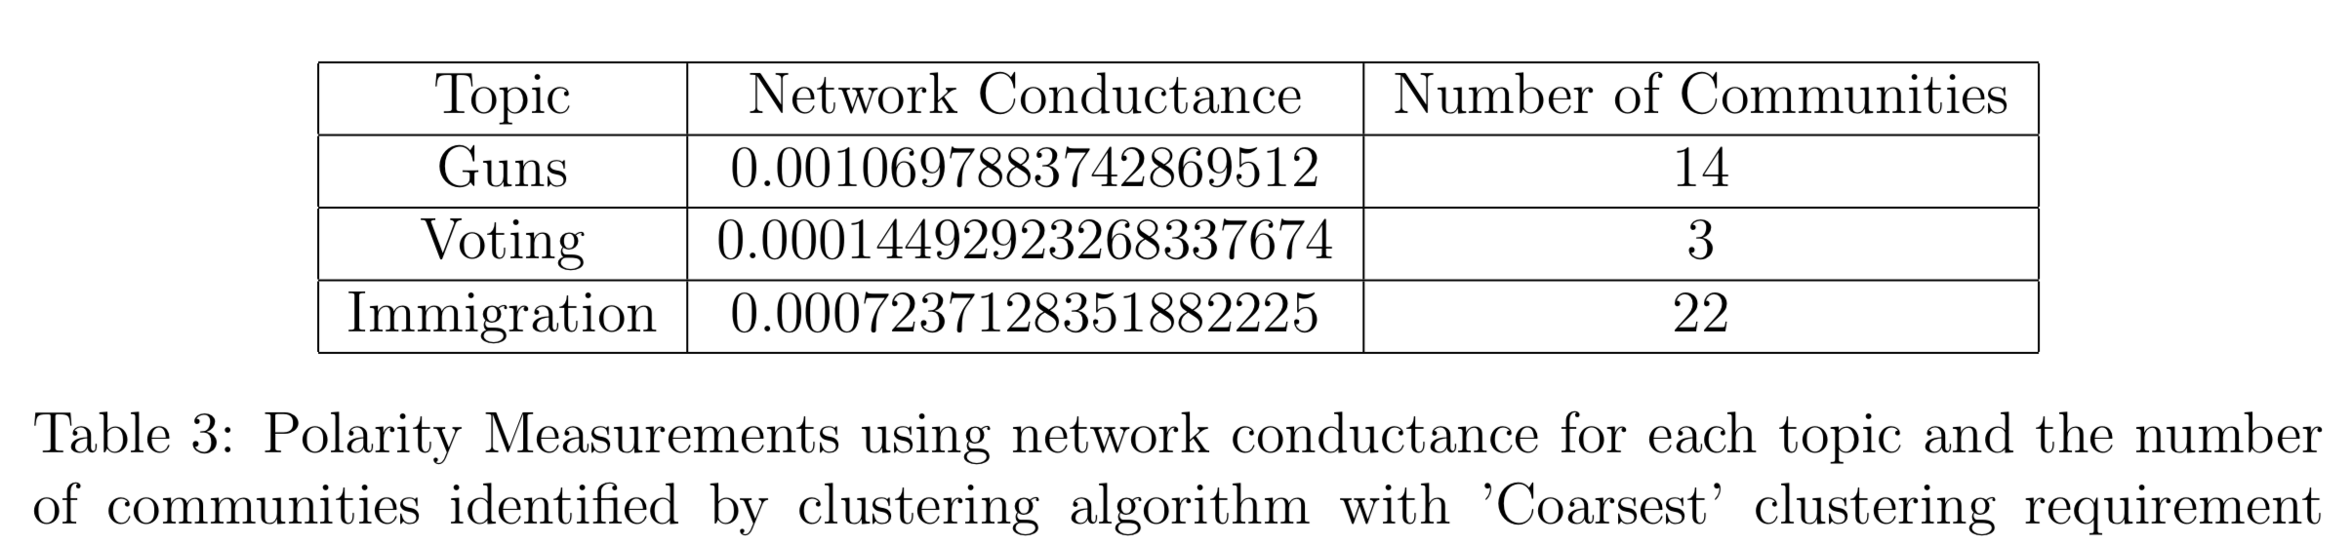
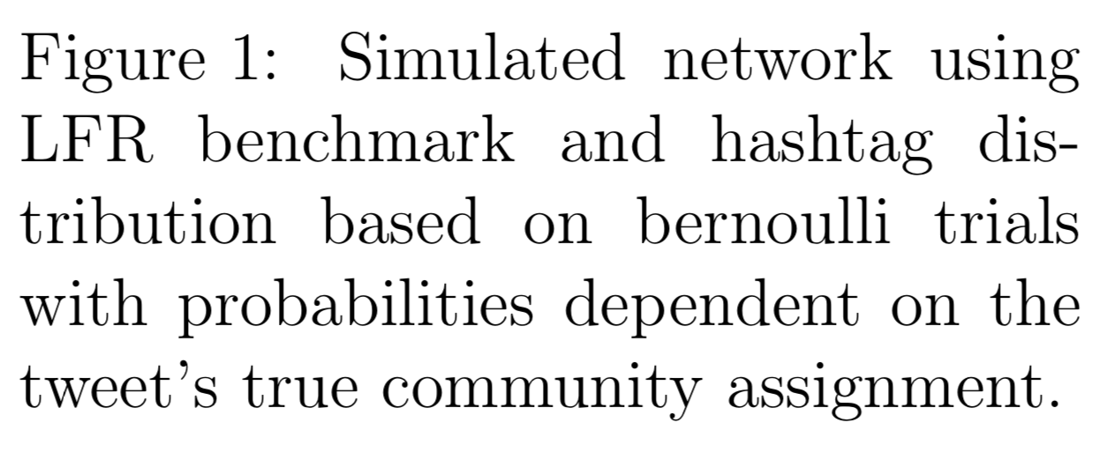
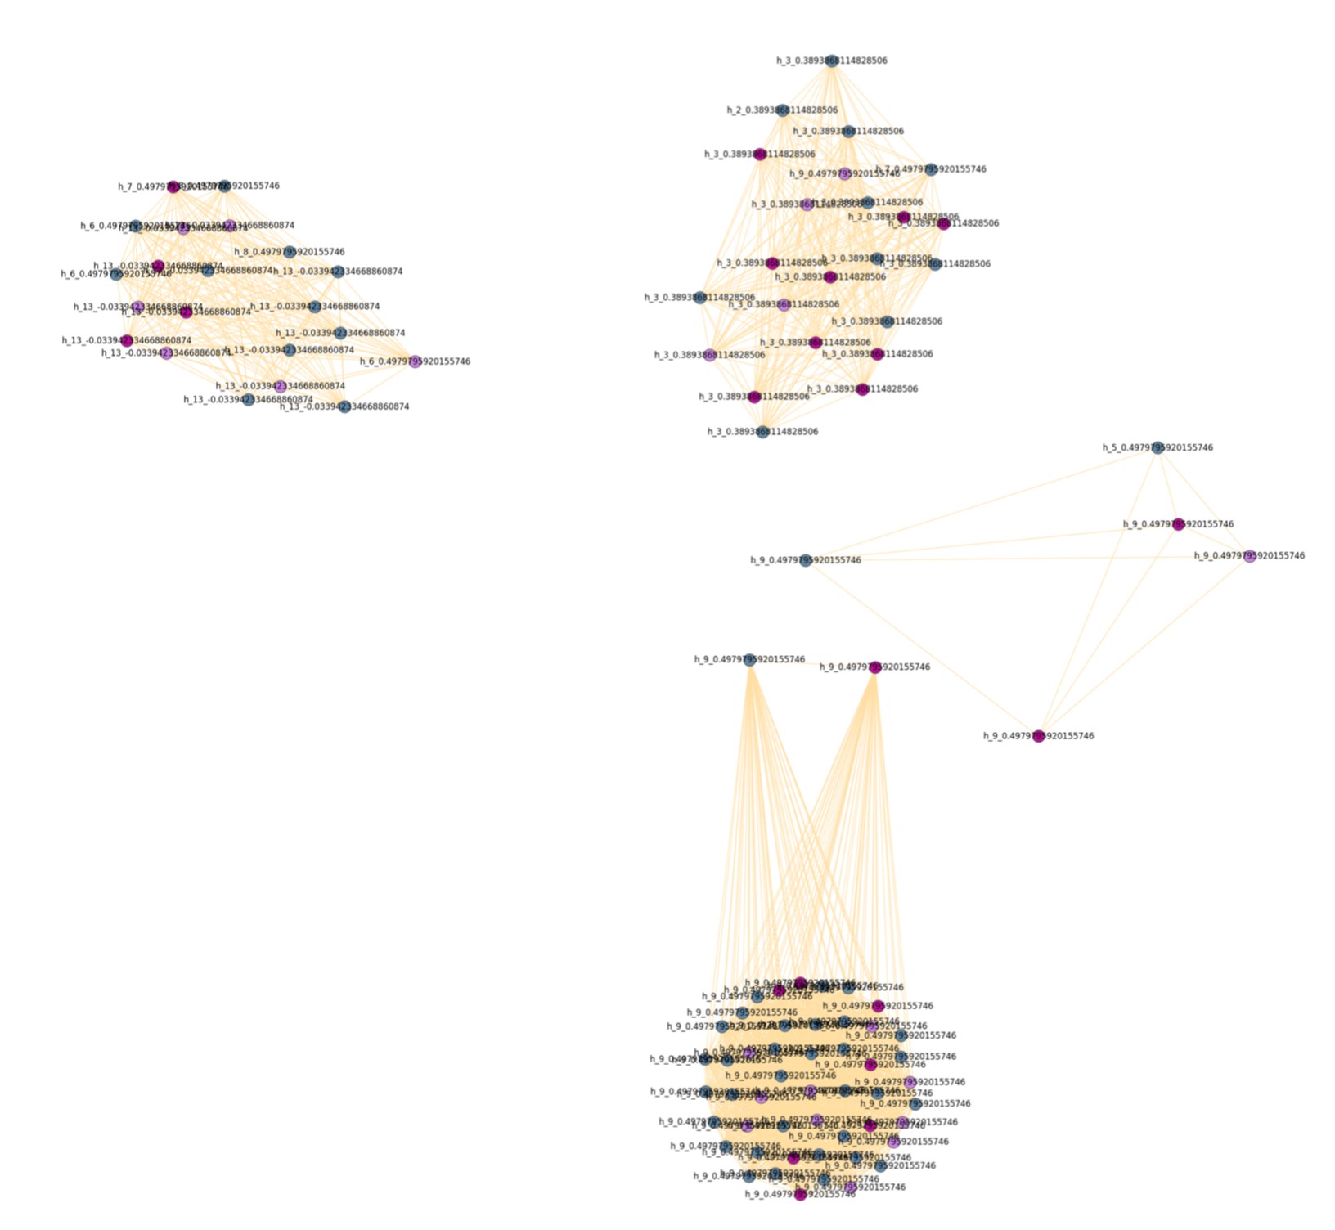
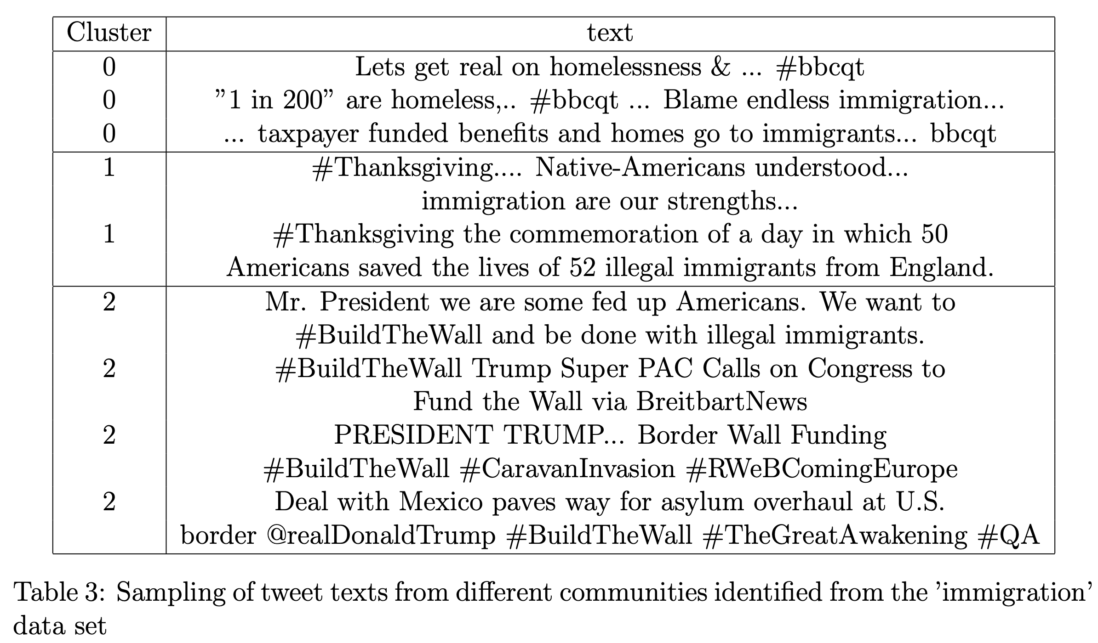
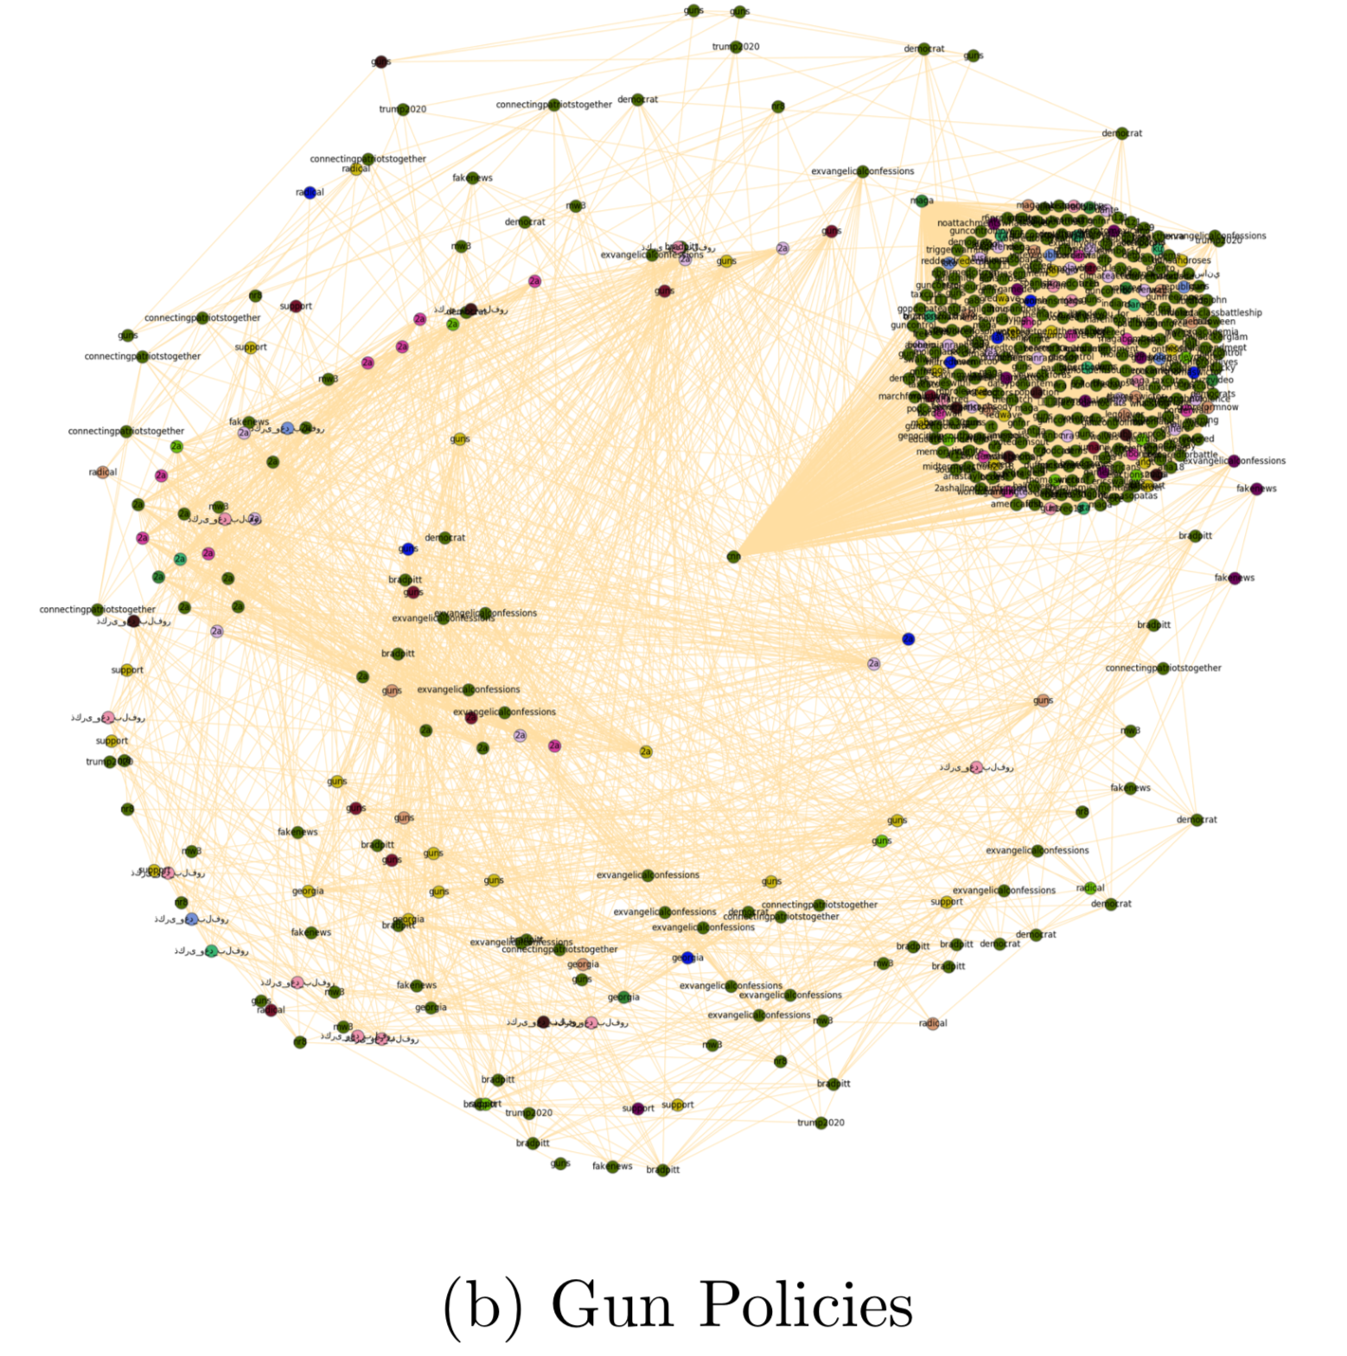
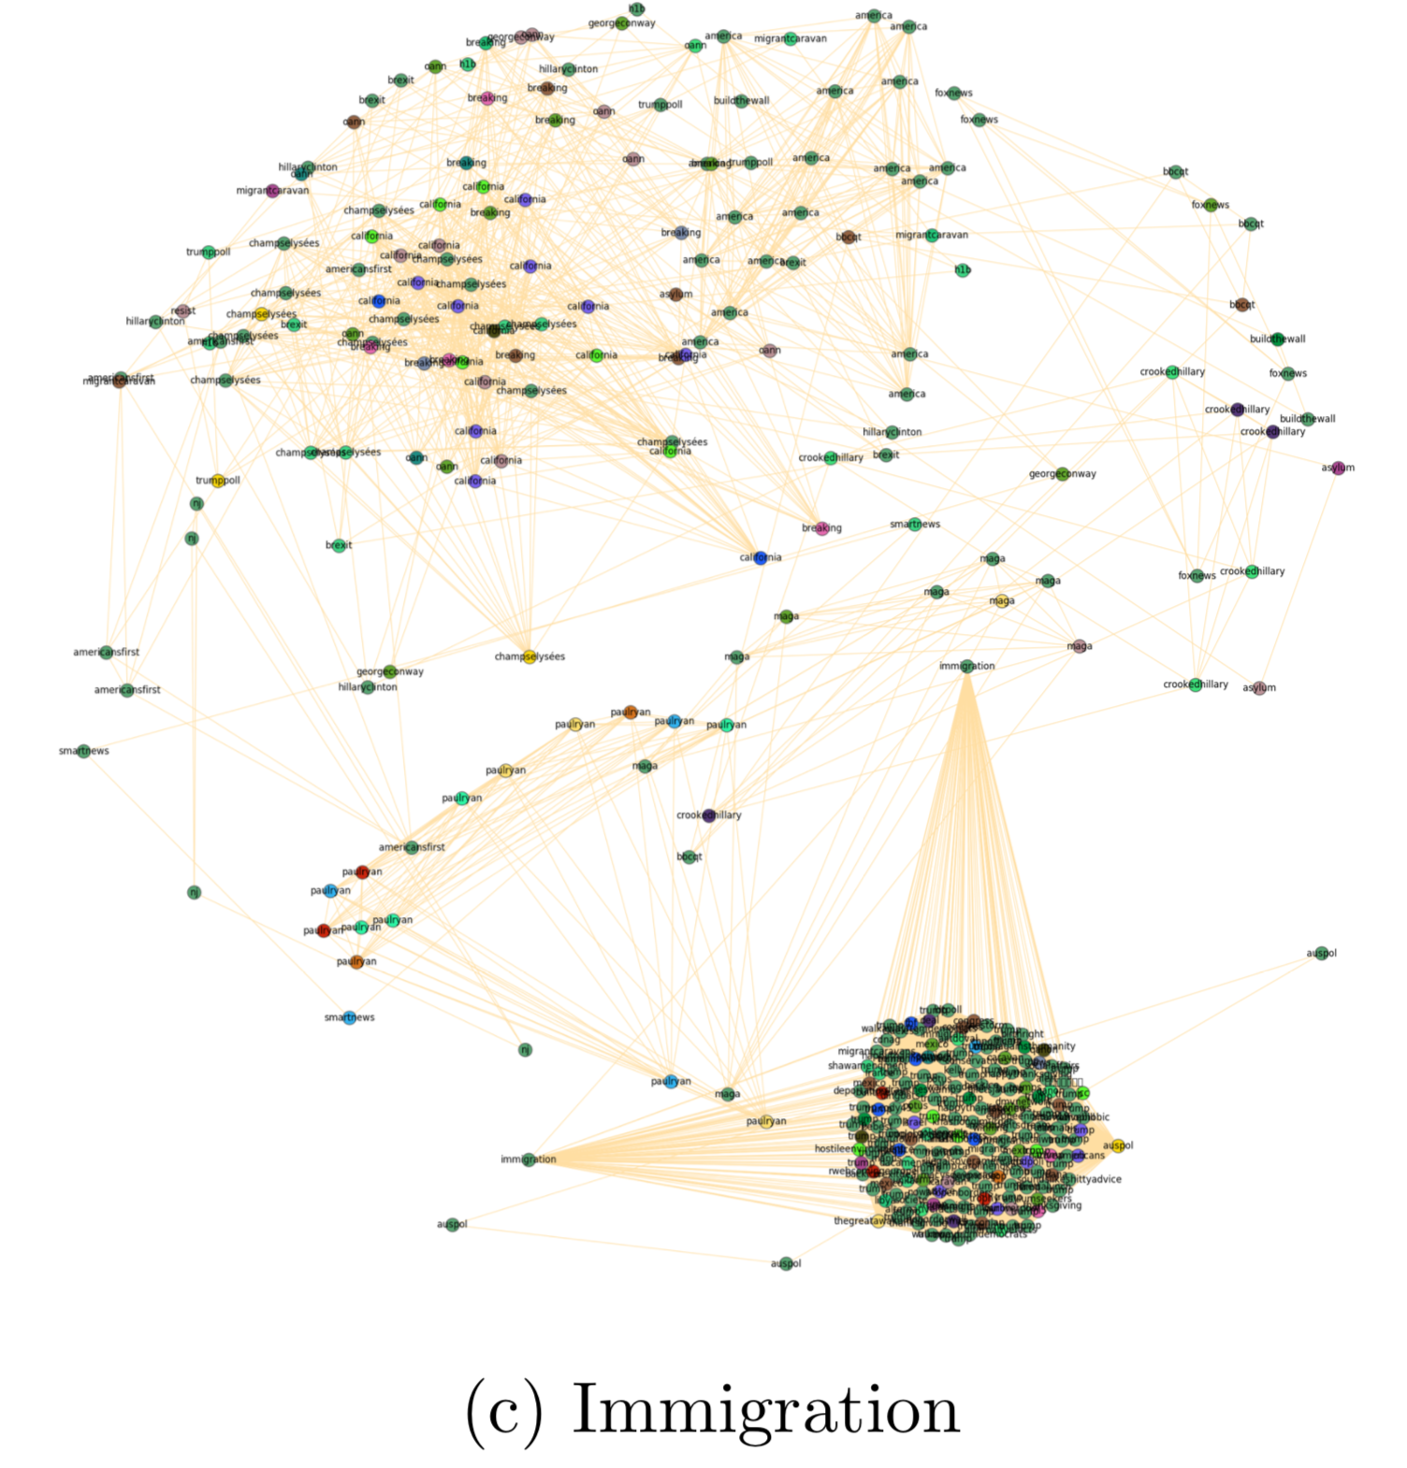
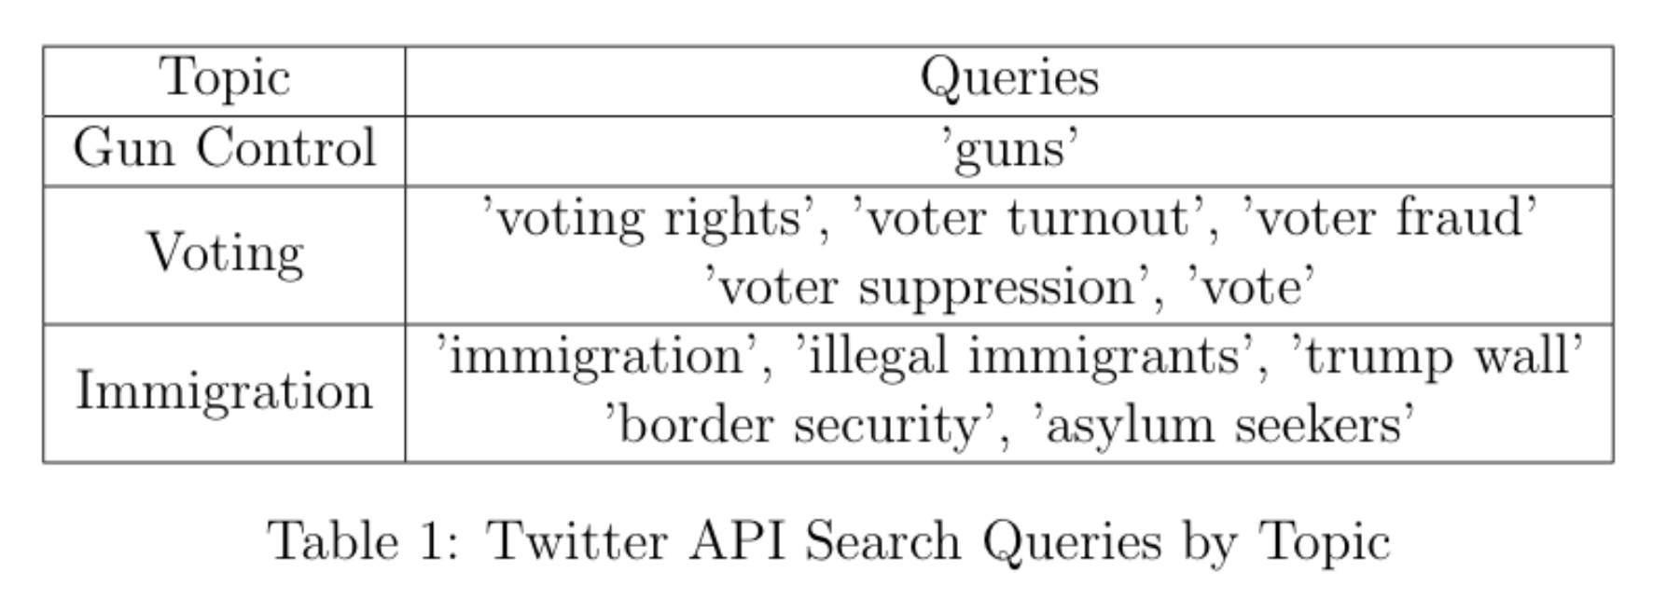
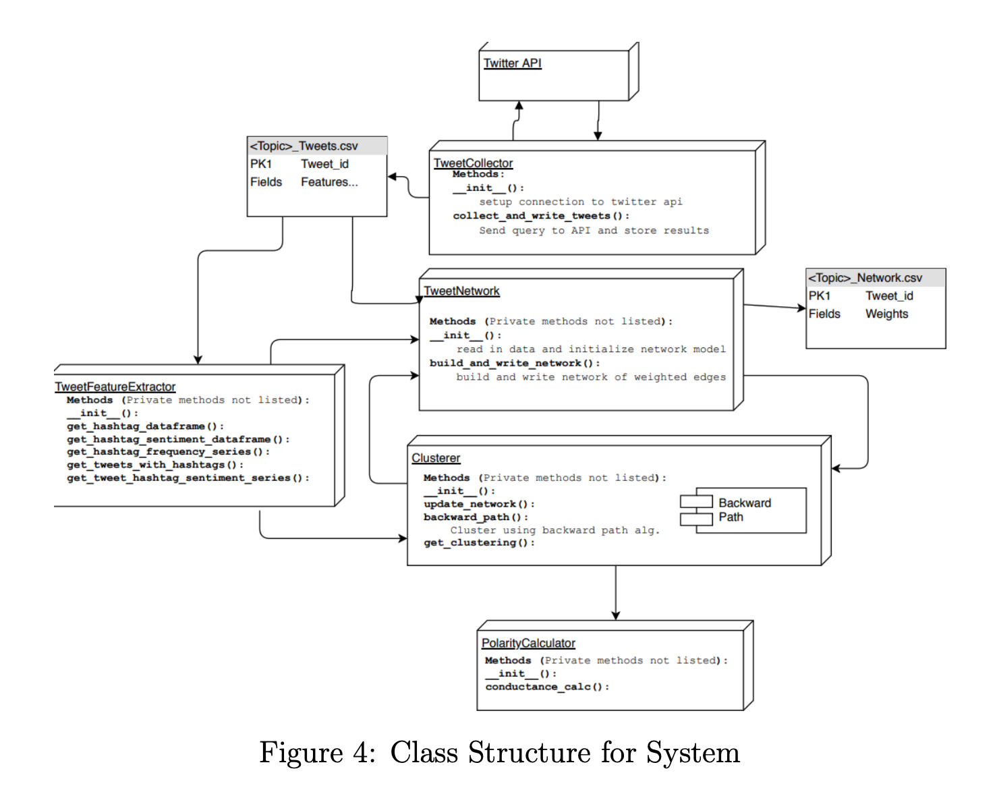
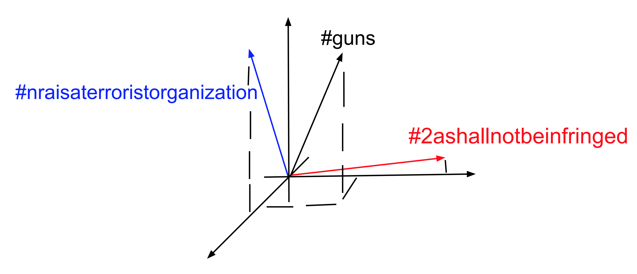
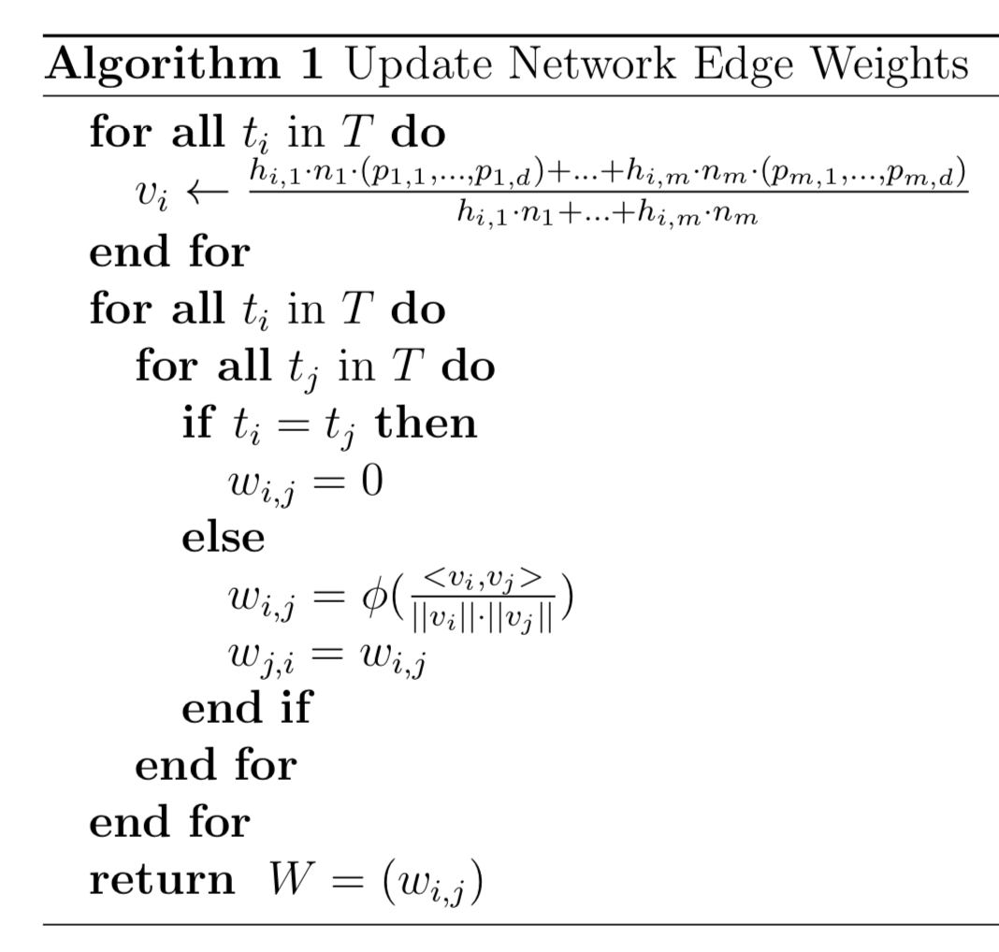
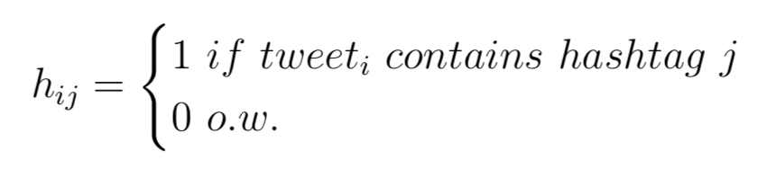
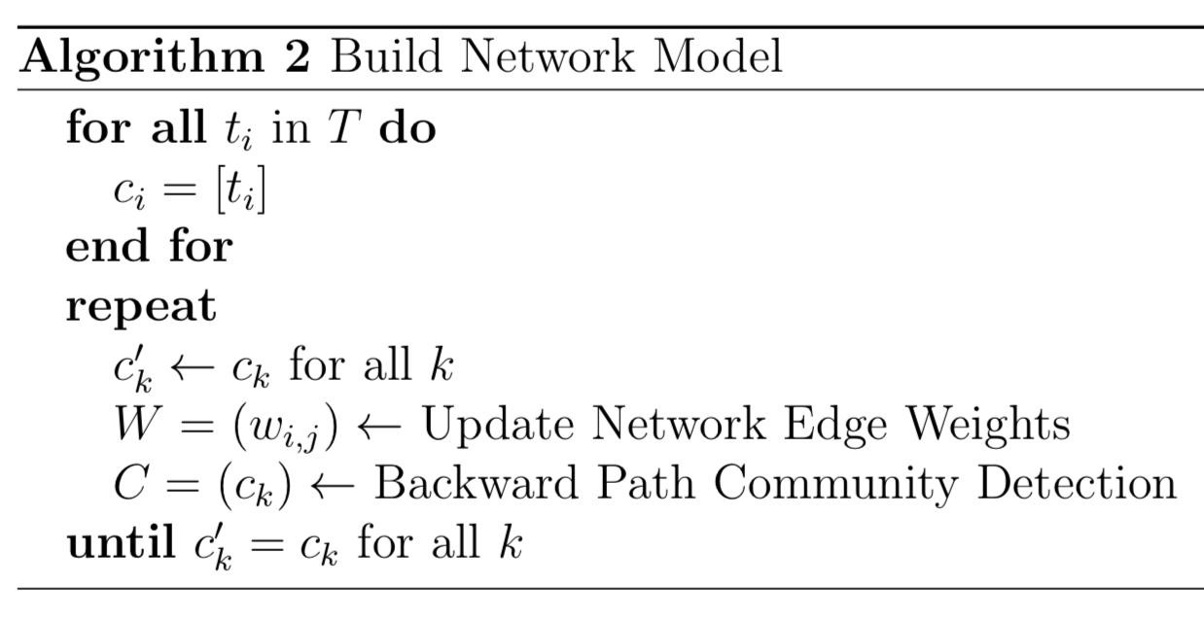
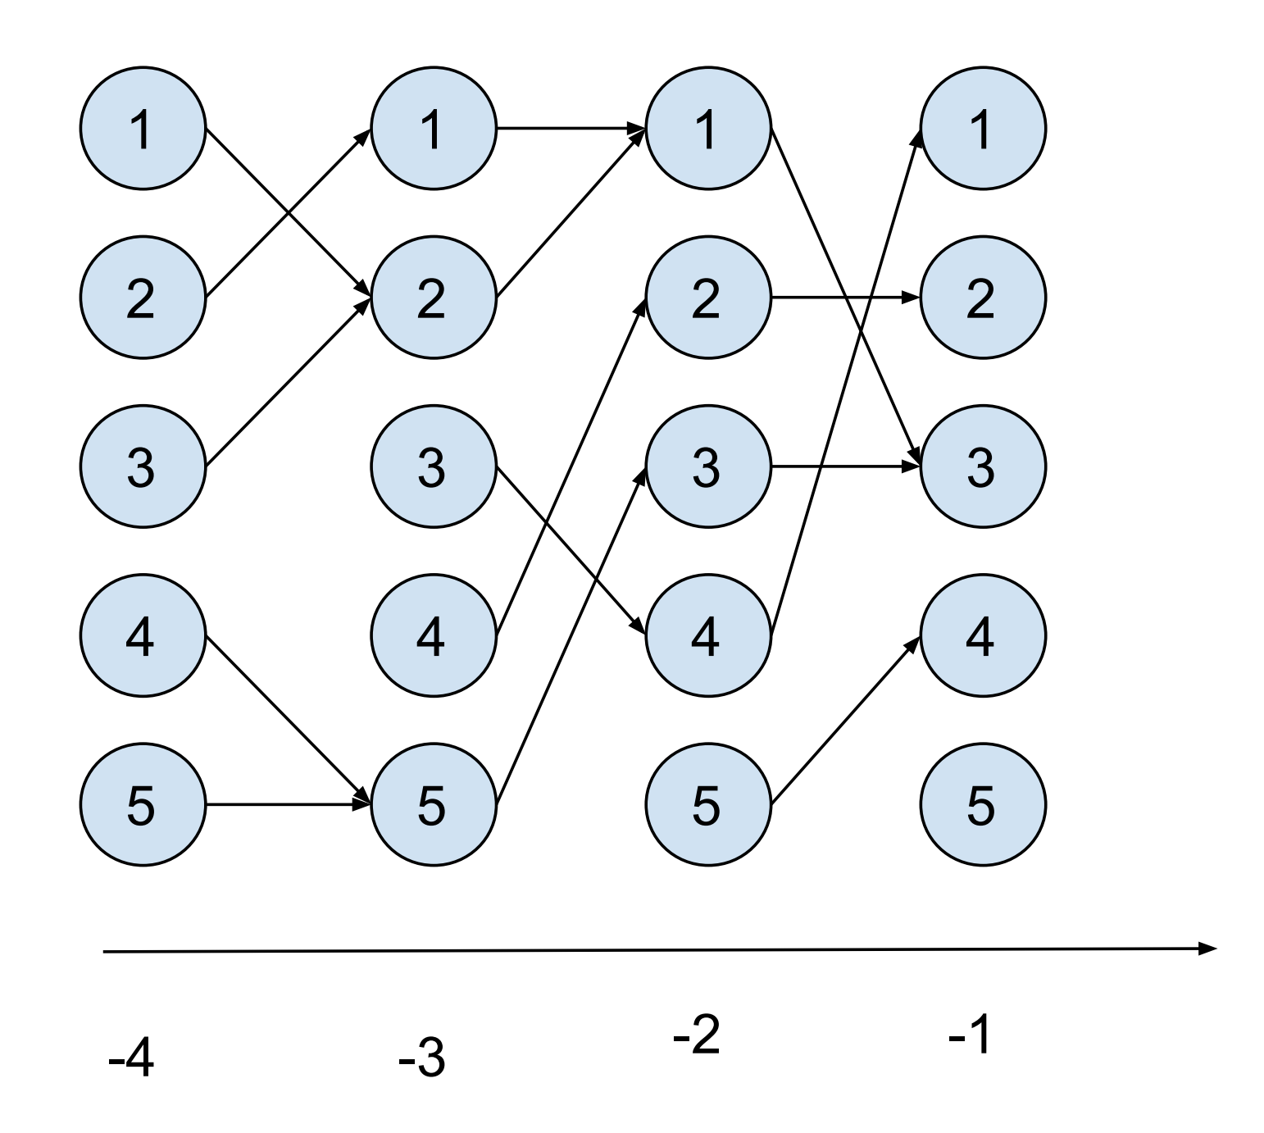
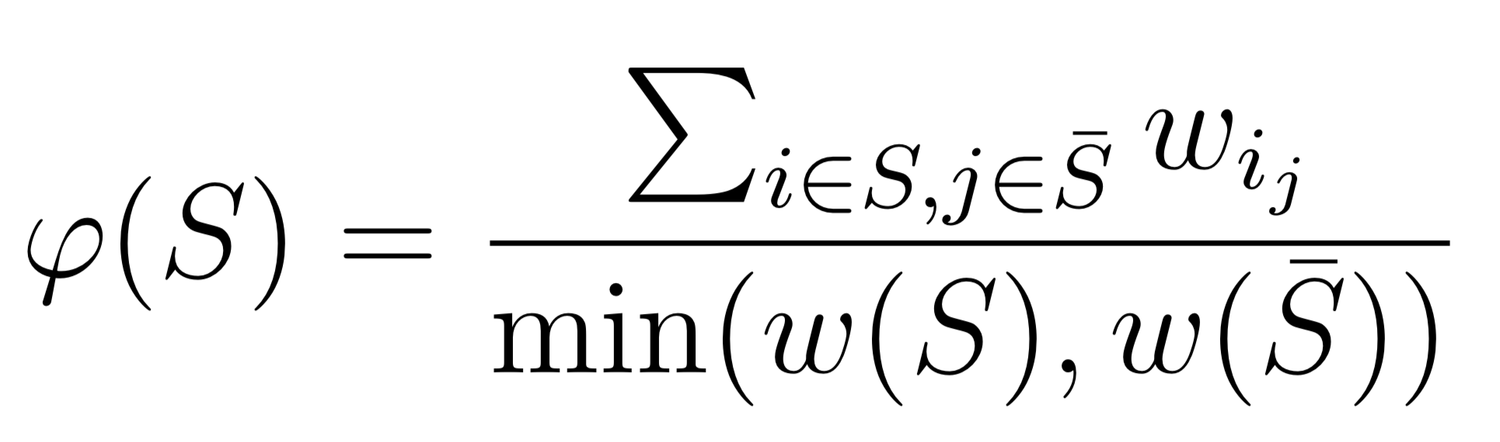
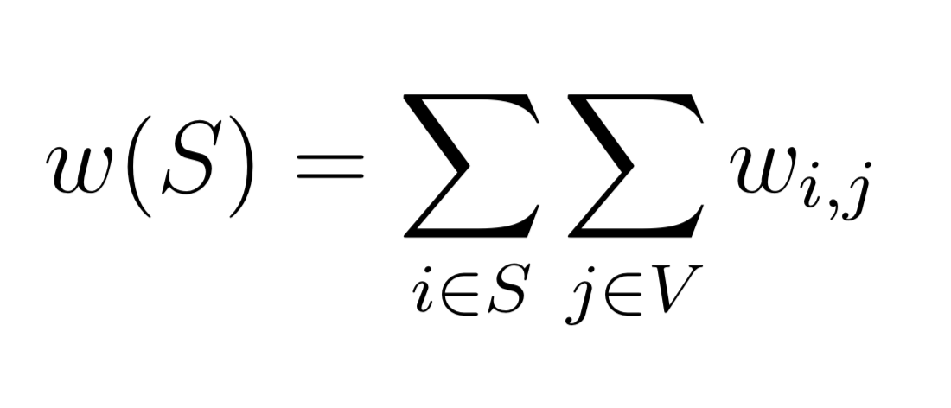

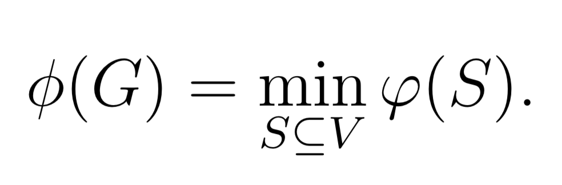

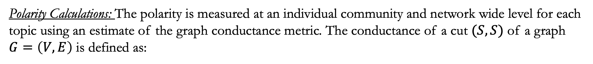
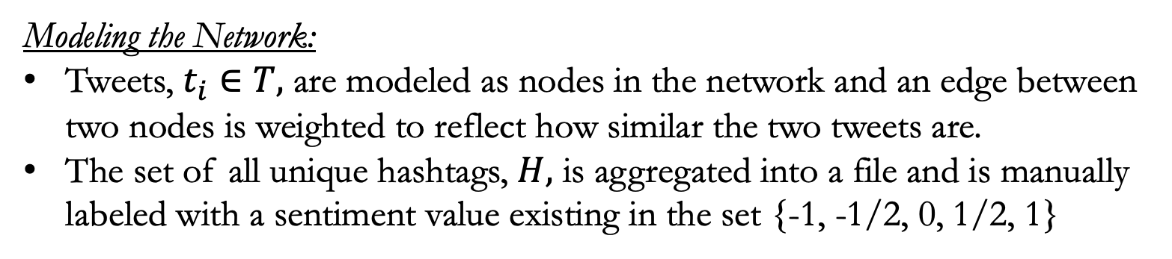
The Polarization of Information on the Web
Charles Dickens, Narayana Prasad Santhanam
Dept. of Electrical Engineering, University of Hawaii at Manoa
Introduction & Motivation
Results & Analysis
Many sources claim that the political climate is becoming increasingly polarized, but few attempt to quantify this feeling. Furthermore, the strict dichotomy of left vs. right is a simple and typically accepted narrative, but perhaps a more fine grained model which considers smaller schools of thought on a topic to topic basis may better capture what is truly happening on the web. With an objective understanding of the polarization of information on the web, researchers could pinpoint causes, and potentially come up with solutions to reverse this concerning trend and foster more fruitful conversation.
Project Description
Popular microblogs such as Twitter have become primary sources of information for many citizens. Twitter encourages users to share their opinions and information about current issues and events, no matter how contrarian, and access to such a variety of viewpoints has the potential to foster awareness. However, it seems groups of society are forming increasingly polarized opinions on topics, leading to disagreements over even factual details. This concerning observation has been a common topic of conversation as of late, but an accepted method for quantifying the polarization between camps on a topic to topic basis has yet to be developed, leaving the dialogue and, as a result, the proposed solutions subjective and difficult to act upon.
The short term objectives of this project are:
Develop a method for comparing the polarization of existing communities of thought at the topic specific level
Improve methods for modeling social networks
The contributions of this report is the framework for a workflow which
Models a network of tweets related to a common topic using a semi-supervised approach
Finds community structure in the model
Measures the polarity using graph conductance.
2
Materials & Methods
Retrieving Relevant Information and Opinions:
Twitter granted this project access the premium search API sandbox, which allows for 25000 tweets to be collected each month.
4
Modeling the Network:
Tweets, $t_{i}∈T,$ are modeled as nodes in the network and an edge between two nodes is weighted to reflect how similar the two tweets are.
The set of all unique hashtags, $H,$ is aggregated into a file and is manually labeled with a sentiment value existing in the set {-1, -1/2, 0, 1/2, 1}
1
Community Detection:
The community detection algorithm used in the system, backward path community detection, was developed at the University of Hawai'i Big Data Lab (Paravi and Santhanam, 2015)
where
Conclusion
3
Our system has analyzed multiple topics of discussion on Twitter and has identified groups that align with our intuitions. The network structure including polarity calculations can be successfully measured and compared across topics.
This implementation has been a proof of concept for the techniques used to build the network model, identify communities, and measure polarity. The system will be developed in future work to consider additional features such as tweet popularity, tweet text sentiment, and more. Moreover, the workflow for collecting the tweets can be modified to minimize bias introduced by using human intuition to create search queries.
Polarity Calculations: The polarity is measured at an individual community and network wide level for each topic using an estimate of the graph conductance metric. The conductance of a cut $(S,S)$ of a graph $G=\left(V,E\right)$ is defined as:
Acknowledgements
where
Special thanks to
CSoI: Center for Science of Information (https://www.soihub.org) is a National Science Foundation Science and Technology Center made possible under grant NSF CCF- 0939370
Then the graph conductance is defined as
University of Hawaii, Department of Electrical Engineering

